Slide 1



ANGLICAN MISSIONS
anglicanmissions.org.nz

Slide 2





25
ANGLICAN MISSIONS
lenten
appea
This Lent, partner with Anglican Missions to support work in The Solomon Islands and the Holy Land.
Your donation will go towards safe water, sustainable agriculture, disaster preparation, counselling, education and much more.
Scan or visit to learn more: anglicanmissions.org.nz/lent

Slide 3

25
ANGLICAN MISSIONS
lenten
appea
WE CHOOSE
HOPE
FOR
THE HOLY
LAND
This Lent, your donation will provide access to healthcare, education and community support for those affected by the Israel/Gaza conflict.
Scan to learn more or visit:
anglicanmissions.org.nz/holy-land

Slide 4


25
ANGLICAN MISSIONS
lenten
appea
ONTONG JAVA RESILIENCE PROJECT
This Lent, your donation provide agriculture, safe water and disaster preparation for the people of Ontong Java - one of the most remotely inhabited islands in the world.
Scan to learn more or visit:
anglicanmissions.org.nz/holy-land

Slide 5
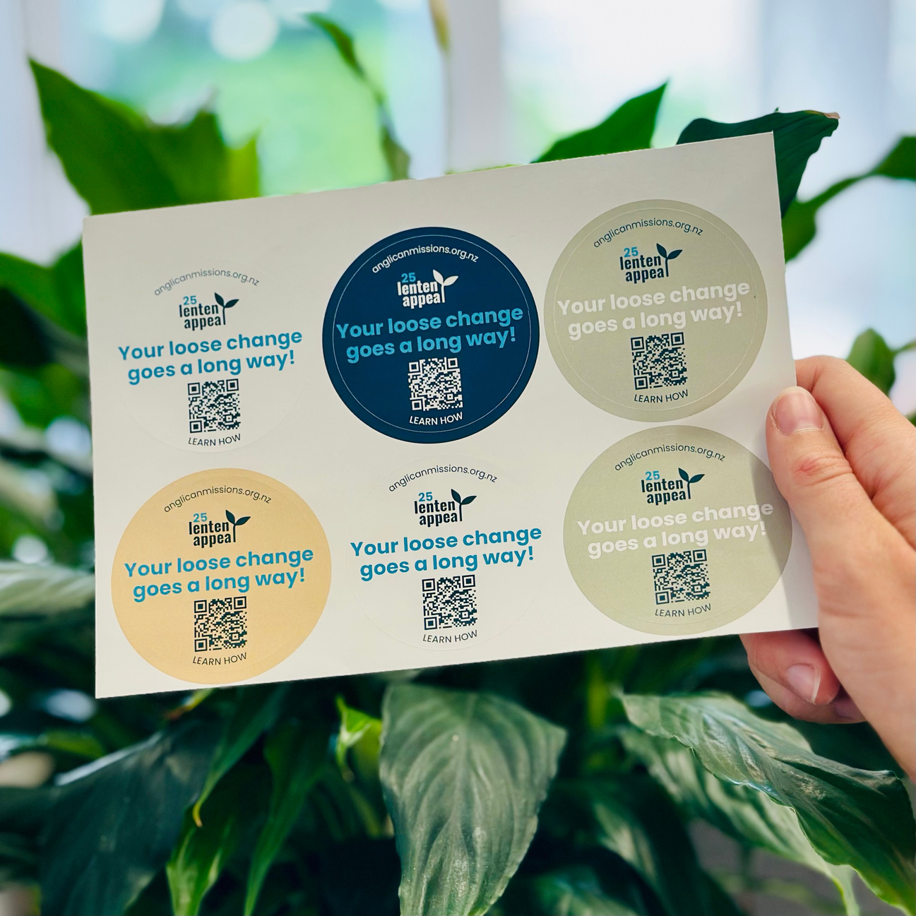
EVERY CENT
IS A SEED.
Look out for the Lenten Appeal sticker at your parish and drop in your loose change. Every cent is a seed that you can plant!

